Slide 1
React Hooks
K.Sajitha

Slide 2
React Hooks
React Hooks are based on the same fundamental principles as React. They try to encapsulate state management by using existing JavaScript features.
We do not need to use class components anymore, because Hooks are simply functions that can be called in function components.
React Hooks solve many problems, especially of larger web applications. Hooks were added in React 16.8, and they allow us to use state, and various other React features, without writing a class

Slide 3
Why Hooks
Function components with hooks no longer need all the life-cycle methods because effects can be encapsulated into hooks. The change leads to neater, better organized code.
The improved organization makes it easier to find the code for a particular effect, see how a component works, and maintain it in the future

Slide 4
Advantages
React can do various optimizations on our code, since it is easier to analyze functions and function calls rather than classes and their complex this behavior.
Hooks make it easier to abstract and share common stateful logic between components.
By using Hooks, we can avoid render props and higher-order components.
Hooks make the code easier to optimize for React.

Slide 5
React Hooks Rules
Hooks can be called at the top level of the following:
React function components
Custom Hooks
Do not call Hooks inside conditions, loops, or nested functions—doing so changes the order of Hooks, which causes bugs

Slide 6
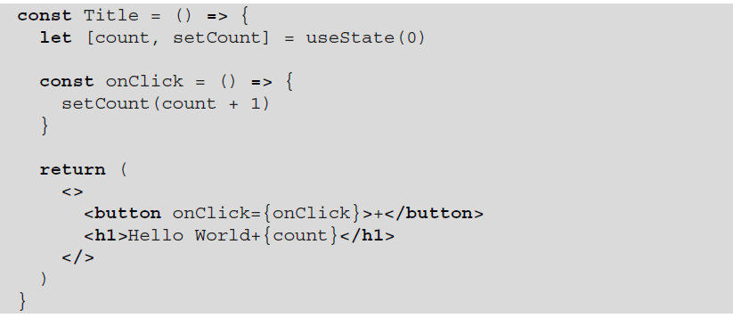
useState
React provides a useState hook to manage the state within function components.

Slide 7
useReducer()
useReducer is usually preferable to useState when you have complex state logic that involves multiple sub-values or when the next state depends on the previous one.
useReducer also lets you optimize performance for components that trigger deep updates because you can pass dispatch down instead of callback

Slide 8
useReducer()
useReducer returns an array with exactly two items:
The current state of this state variable, initially set to the initial state you provided.
The dispatch function that lets you change it in response to interaction.

Slide 9
useReducer Example
useReducer accepts a reducer function and the initial state.
import { useReducer } from 'react'; function reducer(state, action) {
// ...
} function MyComponent() {
const [state, dispatch] = useReducer(reducer, { age: 42 });
// ...

Slide 10
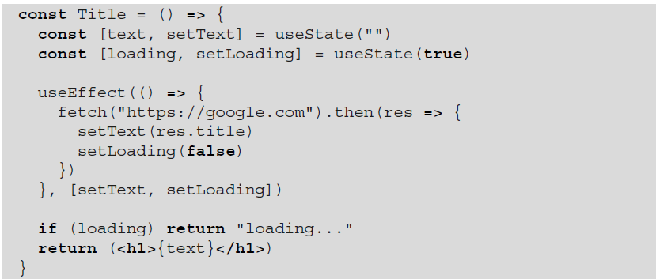
useEffect
The useEffect hook is normally used for any side effect – whether that is to read from an external object or write to an external object
useEffect is asynchronous

Slide 11

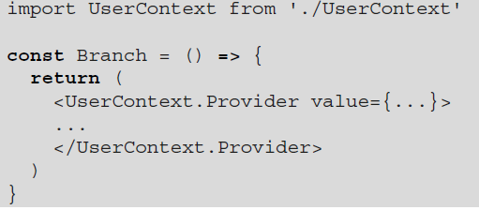
Context API
We can create a context with the createContext function.
The context allows us to provide the value to all consumers underneath via a Provider property:

Slide 12
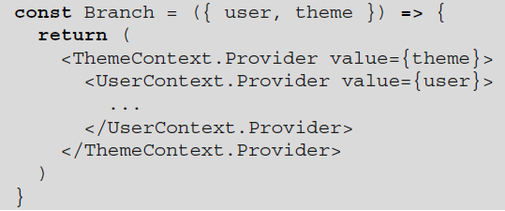
Context provider
A context provider, such as UserContext.Provider, accepts a value prop to share. The provider is a special component. Unlike a function component, it has its own update implementation.

Slide 13
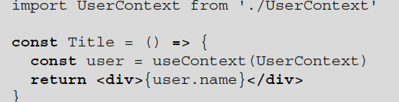
useContext
React provides a useContext hook to consume a context:
The useContext hook function takes one input argument, context, and returns the shared value. context is normally imported from a definition file.

Slide 14
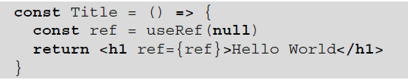
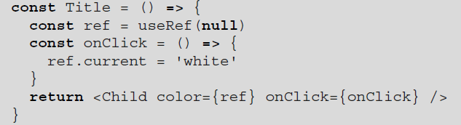
useRef
The useRef hook takes an initial value as its only input argument and returns a ref object, putting that initial value under the current property.
The ref created via useRef can be used to hold not only a DOM instance but also any value.
The useRef hook is a React-supported way to bypass the React engine.

Slide 15
useMemo()
React provides a special Hook called useMemo that you can use to preserve parts of your component across re-renders.
The Hook takes two arguments. The first argument is a function that will return the value you want to memoize.
The second argument is an array of dependencies. If a dependency changes, useMemo will re-run the function and return a value.
useMemo Hook can be used to run the function only when certain dependencies change

Slide 16
useCallback()
useCallback Hook is similar to useMemo : it takes a function as the first argument and an array of dependencies as the second argument.
The difference is that useCallback returns the function and not the result of the function. Like the useMemo Hook, it will not recreate the function unless a dependency changes.

Slide 17
When to use memoization ?
You can use memo , useMemo , and useCallback to avoid costly component re-renders. But all these strategies include a performance cost of their own.
memo will take extra work to compare properties, and the Hooks will need to run extra comparisons on each render.
Only use these tools when there is a clear need in your project, otherwise you risk adding in your own latency.

Slide 18
When to use useRef()
You may want to use setTimeout or setInterval as part of an animation, so you need to keep hold of the IDs they return.
Or you may want to work with DOM form elements as uncontrolled inputs, so you need to keep hold of references to those elements.
Either way, you may not need to display these values to the user, and so changing them shouldn’t automatically trigger a re-render.

Slide 19
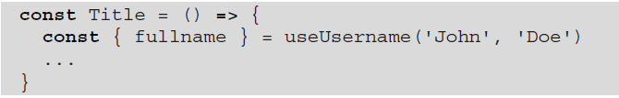
Custom Hook
A custom hook is that it meets the following requirements:
It is a function.
It is named with the prefix use.
It consumes at least one built-in hook.

